Slide 1
Getting Started With Node.js
Introduction to Node.js | Installing and Running | Creating a Simple Web Server | Projects and NPM | The package.json and package-lock.json files
Notes:
Welcome to our lecture on Node.js. In this lecture we will go through its introduction, how to install and run node, creating a simple web server, projects and npm in node, and package dot JSON and package lock dot JSON file. Let’s start the video lecture.

Slide 2
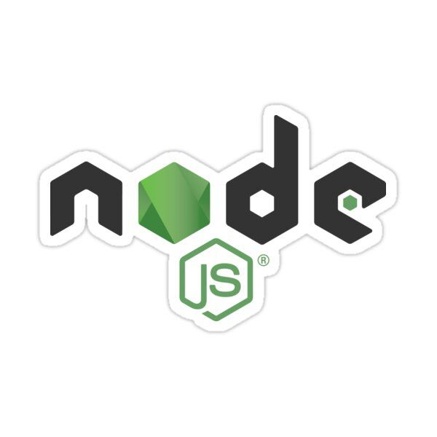
Introduction to Node.js
High Performance: Event-driven, non-blocking I/O handles high loads.
Unified Language: JavaScript on both server and client.
Modularity: Easy creation and distribution of modules.
MongoDB Integration: Uses JSON for seamless client-server-database communication.
Notes:
Let's introduce Node.js. It offers high performance with event-driven, non-blocking I/O for handling high loads. Node.js uses JavaScript on both server and client sides, enabling a unified language. It supports modularity for easy module management. Its seamless integration with MongoDB allows efficient JSON-based data communication.

Slide 3
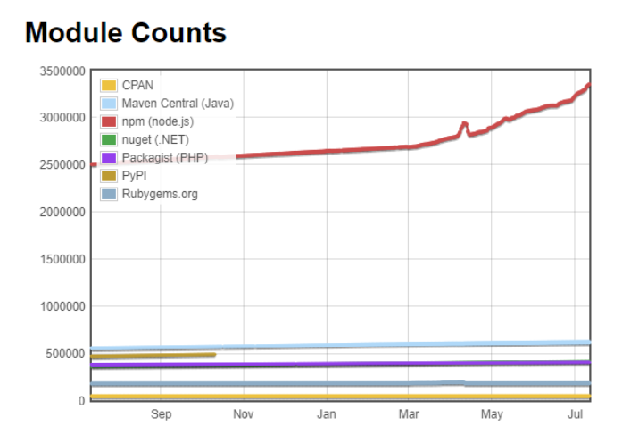
Number Public Node Modules
Notes:
Continuing from Node.js features, let's look at the growth of public Node modules. The graph shows NPM leading with the highest number of modules compared to other package managers like Maven, NuGet, and PYPI. This rapid growth demonstrates the active community and extensive library support, making Node.js a powerful choice for web development.

Slide 4
Installing and Running
Installation: Download installers from the Node.js website for all major OS.
Interactive Shell: Start by entering node in the command line.
Exit Shell: Use the .exit command to quit the interactive shell.
Notes:
Transitioning from Node modules, let's see how to install and run Node.js. Installation is straight forward, download installers from the Node.js website for your operating system. Start the interactive shell by entering node in the command line. To exit, use the dot exit command. This setup lets you quickly test and run JavaScript code.

Slide 5
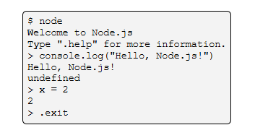
Node.js Interactive Shell
Notes:
Continuing from installation, let's explore the Node.js interactive shell. Start it by typing node in the command line. You can execute JavaScript code directly, like using console.log to print messages or defining variables. The shell immediately evaluates expressions. To exit, simply type .exit. This interactive environment is great for quick testing and debugging.

Slide 6
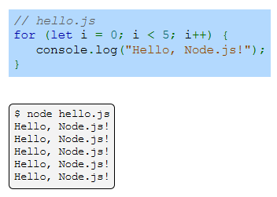
Simple Node.js program
Notes:
Building on the interactive shell, here's a simple Node.js program. This example uses a for loop to print Hello, Node.js five times. The code is saved in a file named hello.js. To run it, enter node hello.js in the command line. Node.js executes the script, displaying the output line by line. This demonstrates how easily Node.js handles basic JavaScript tasks.

Slide 7
Creating a simple web server
http Module: Creates a web server with createServer() and listens with listen().
Running Server: Stays active until stopped with Ctrl+C.
Module Import: Use require() to import modules in Node.js.
Notes:
Continuing from simple programs, let's create a basic web server in Node.js. Use the http module's create Server method to set up the server and listen with listen. The server stays active until stopped with Ctrl plus C. Import modules using require. This allows you to build lightweight web servers quickly, showcasing Node.js's power and simplicity.

Slide 8
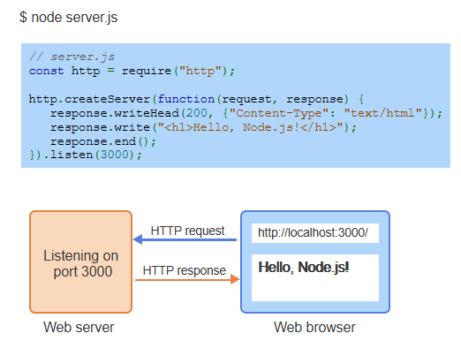
Example
Notes:
Building on creating a web server, here's an example using Node.js. The server.js file imports the http module and uses create Server to respond with Hello, Node.js. It listens on port 3000. When you visit localhost 3000 in a browser, the server sends an HTTP response displaying the message. This demonstrates how easily Node.js handles HTTP requests and responses.

Slide 9
Projects and npm
Node.js Projects: Organized into directories with JavaScript files and configuration.
Packages: Contain modules and a package.json file with metadata and dependencies.
npm: Manages packages (install, update) and is included with Node.js.
Notes:
Continuing from the web server, let's explore Node.js projects and npm. Projects are organized into directories with JavaScript files and configuration. Packages contain modules and a package dot json file with metadata and dependencies. npm, included with Node.js, manages packages by installing and updating them, streamlining project management.

Slide 10
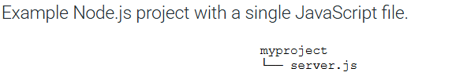
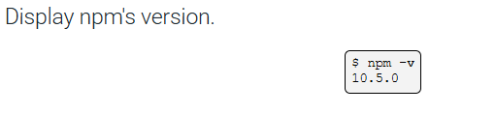
Example
Notes:
Continuing with projects and npm, here's an example. This Node.js project has a simple directory structure with my project containing a single JavaScript file, server.js. To check npm's version, use the command npm hyphen v, which displays the installed version. This setup demonstrates how to organize Node.js projects and manage dependencies efficiently.

Slide 11
npm Installation Modes
Local Mode: Installs in node_modules within the project folder (e.g., npm install mypackage).
Global Mode: Installs globally with -g flag (e.g., npm install mypackage --global).
Usage: Local for project dependencies, Global for command-line tools.
Notes:
Building on npm, let's look at installation modes. In Local Mode, packages are installed in the node modules folder within the project, using npm install my package. Global Mode installs packages system-wide with the -g flag, like npm install my package global. Local Mode is for project dependencies, while Global Mode is ideal for command-line tools.

Slide 12
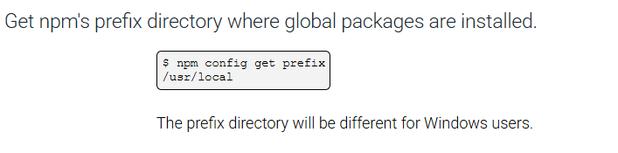
Example
Notes:
Continuing with npm installation modes, here's how to find the global installation directory. Use the command npm config get prefix to get the prefix directory where global packages are installed. On Unix systems, it's usually usr local. This directory may be different for Windows users, helping manage where global tools are stored.

Slide 13
Useful Node.js Tools
Nodemon: Auto-restarts Node.js app on file changes.
Underscore: Utility library with helpful JavaScript functions.
Local Install: Stored in node_modules (e.g., myproject/node_modules/underscore).
Notes:
Transitioning from npm installation, let's look at useful Node.js tools. Nodemon auto restarts a Node.js app when files are modified, speeding up development. Underscore is a utility library providing helpful JavaScript functions. When installed locally, packages are stored in the node modules folder, like my project node modules underscore.

Slide 14
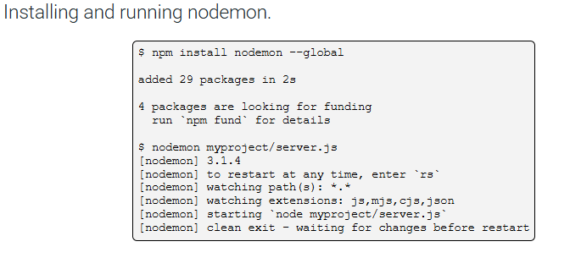
Example
Notes:
Continuing with useful tools, here's how to install and run Nodemon. Use npm install nodemon global to install it globally. Then start the app with nodemon my project server.js. Nodemon watches for file changes and automatically restarts the server, streamlining development by eliminating the need to manually restart after edits.

Slide 15
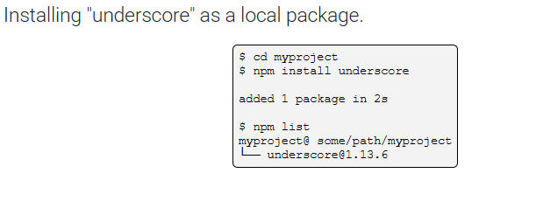
Example (Continue)
Notes:
Continuing with package installation, here's how to install Underscore as a local package. First, navigate to your project directory with cd my project. Then run npm install underscore to install it locally. Once installed, use npm list to view the installed packages and confirm that Underscore is listed in your project’s node modules.

Slide 16
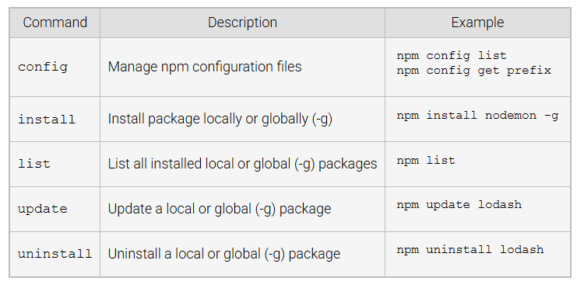
npm Commands
Notes:
Now, let's look at some important npm commands. Use npm config to manage configuration files, like npm config get prefix. Install packages locally or globally with npm install, for example, npm install nodemon hyphen g. Use npm list to view installed packages, and npm update or npm uninstall to update or remove them as needed. These commands help manage your Node.js environment efficiently.

Slide 17
The package.json and package-lock.json files
package.json and package-lock.json
package.json: Lists project info (name, version, dependencies); created with npm init.
package-lock.json: Locks dependency versions for consistent installs across machines.
Versioning: ^ allows updates within the same major version (e.g., ^1.9.1 → 1.9.x).
Notes:
Now, let's talk about the package.json and package-lock dot json files. The package.json file lists important project details, like the project name, version, and dependencies, and is created using npm init. The package-lock.json locks the exact versions of dependencies for consistency across different machines. Versioning with the caret symbol allows updates within the same major version, ensuring compatibility.

Slide 18
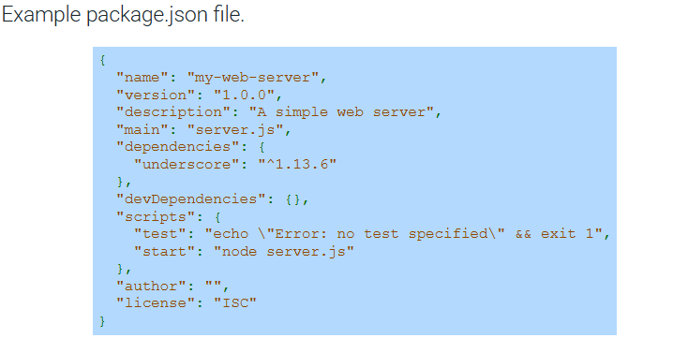
Example
Notes:
Here is an example of a package.json file. It includes important project details such as the name, version, description, and main file. In this case, the project is a simple web server, and it has a dependency on Underscore. The scripts section includes commands for testing and starting the server, while the author and license fields are left empty. This file helps manage project dependencies and scripts.

